Slide 1

ECEN 461
Real-Time and Embedded Systems
IOT – Internet of Things
Information

Slide 2

IOT
Internet of Things
Devices that are always available and always connected

Slide 3
IOT
Internet of Things
Devices that are always available and always connected
Power
Communications
Information

Slide 4
Sine and Cosine Functions
Understanding and using sinusoids critical to DSP so, lets review sine and cosine
First, how are sine and cosine related?

Slide 5
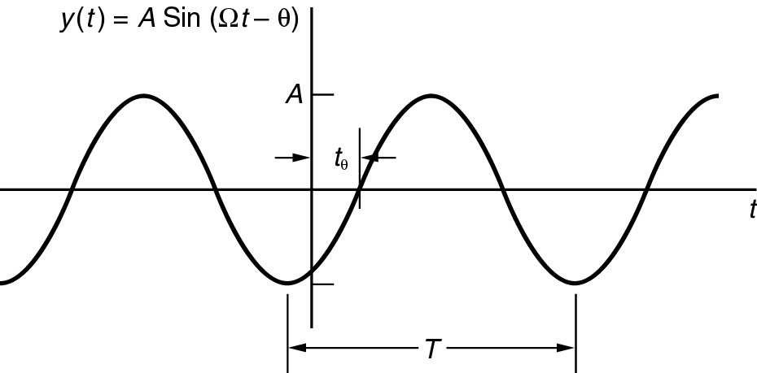
Continuous-Time Sinusoid
Review: What is the formula for this?
AMPLITUDE
magnitude
FREQUENCY
Rad/sec
Hertz (cycles/sec)
PHASE

Slide 6
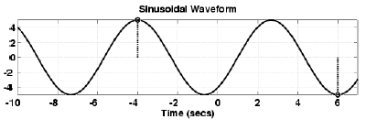
Example of Sinusoid
Peak, Period?
Given the Formula
What does the plot look like?

Slide 7
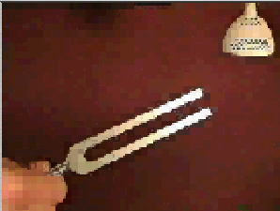

Tuning Fork
CD-ROM demo
“A” is at 440 Hz
What type of waveform?
Sinusoidal Signal
Mathematical formula?

Slide 8
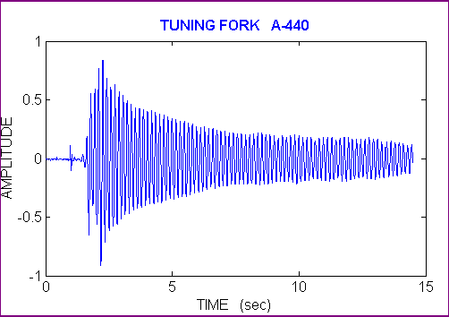
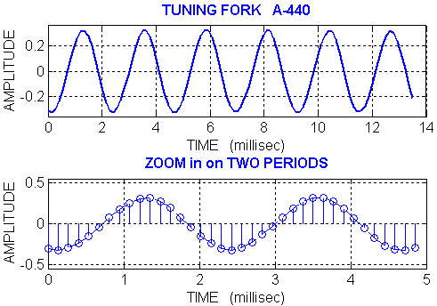
Tuning Fork Waveform
What is the period of this signal?
T = 8.15 – 5.85ms
T = ~2.3 ms
What is the frequency?
F = 1/T
F = 1/2.3ms
F = ~440 Hz

Slide 9
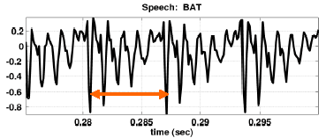
Speech Signal
More complicated signal (BAT.WAV)
What type of waveform?
x(t) is NOT a sinusoid
Math formula?

Slide 10
Speech Signal - Bat
Nearly periodic in vowel region
Period is (Approximately) T = 0.0065 sec
Math Formula?
Fourier Theory tells us
x(t) can be approximated by a sum of sinusoids
Fourier Analysis
Break x(t) into its sinusoidal components (called Freq Spectrum)

Slide 11
Sinusoidal Addition
Fourier Theory tells us x(t) can be approximated by a sum of sinusoids
So, suppose we want to add just 2 sinusoids
How do we do this?
We can use Trig
We can use phasors

Slide 12
Phasor Addition
For these 2 sinusoids – convert to phasor form
Convert to Rectangular
X₁ = 0.5814 + j1.597
X₂ = -1.785 – j0.6498
Add
X₃ = -1.204 + j0.9476
Convert back
What if we had 10 sinusoidal signals to add? How easy would that be?

Slide 13
Complex Exponential Signals
Phasor notation works fine for sums of just a couple of sinusoids, but is clumsy for sums of many sinusoids
Analysis and manipulation of sinusoidal signals if often greatly simplified by dealing with related signals called complex exponential signals
Who remembers how exponentials and sinusoids are related?

Slide 14
Complex Exponentials
Euler’s formula for complex exponentials
So, for
What would it look like in rectangular form?

Slide 15

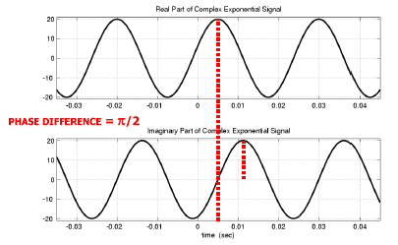
Real & Imaginary Part Plots

Slide 16
Euler’s Identity
What is the real part of a complex exponential?
So a general sinusoid
Can be represented as ,

Slide 17
Complex Amplitude
General Sinusoid
We can define the Complex Amplitude = X
Then, any Sinusoid = Real Part of Xe^{jwt}

Slide 18
Complex Amp Example
Find the Complex Amplitude for:
Use Euler’s Identity:
It turns out that the complex amplitude = the phasor notation we used before

Slide 19
Complex Exponential Addition
So if we want to add these 2 sinusoids
We can do this 3 ways
We can use Trig
We can use phasors
We can use complex exponentials

Slide 20
Complex Exponential Addition
For these 2 sinusoids – convert to exponential form
Convert to Rectangular
X₁ = 0.5814 + j1.597
X₂ = -1.785 – j0.6498
Add
X₃ = -1.204 + j0.9476
Convert back

Slide 21
A Typical DSP System
Digital
Proc
Sample/Hold – Takes snapshots of input signal and holds the signal long enough for the A/D converter to convert
A/D – converts the CT signal to digital signal
Digital Process – algorithm used to change the signal
D/A – converts digital signal to analog signal
LPF – smoothes discrete edges of D/A signal

Slide 22
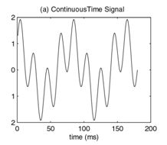
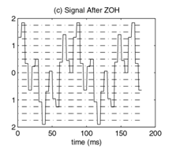
A Typical DSP System
Digital
Proc

Slide 23
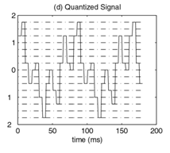
A Typical DSP System
Digital
Proc

Slide 24
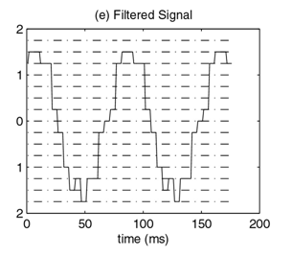
A Typical DSP System
Digital
Proc

Slide 25
A Typical DSP System
Digital
Proc

Slide 26
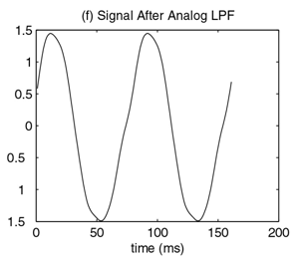
A Typical DSP System
Digital
Proc

